Slide 1
Joke Recommender system
-Sekhar Mekala

Slide 2
Objective and Background
Objective:
Build a recommender system using the jokes data set (Dataset 2) present at http://eigentaste.berkeley.edu/dataset/
Background:
The data is related to the Jester project at UC Berkeley.
The data set has more than 1.7 million ratings provided by 59132 users for 150 jokes
Users provide ratings to jokes at the website http://eigentaste.berkeley.edu

Slide 3
Recommenders
Created 2 recommenders:
Recommender-1: Collaborative recommender system based on the cosine similarity between the pair of jokes
Used PySpark to build the recommender along with Python programs to make recommendations
Recommender-2: Recommender based on SGD (Stochastic Gradient Descent)
Obtained an average AUC (Area Under the Curve) of 0.8
Built the recommender on a laptop with 16 GB RAM
These recommenders were built as generic as possible
See the complete project at:

Slide 4
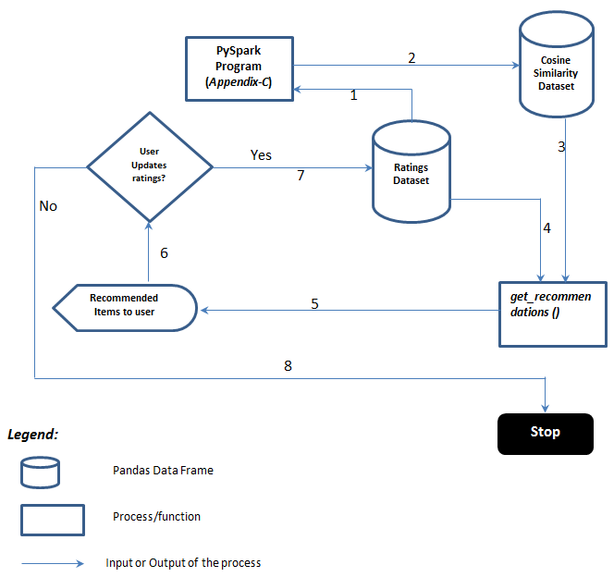
High level design of Recommender-1
Steps:
The Ratings Dataset is supplied as input to the PySpark program (in Appendix-B of the main document)
The PySpark program produces a file Cosine Similarity dataset with cosine similarity scores between the jokes, which are rated in common by at least one user
The get_recommendations() is called with the Cosine Similarity Scores and user ID as inputs
The get_recommendations() function will use Ratings Dataset to determine the items, which were already liked by the user
Based on the items which were liked by the user, the get_recommendations() function will recommend items to the user
Check if the user updates the item ratings
If user updates any item ratings (implicit or explicit updates), update the Ratings Dataset and call get_recommendations() again
8.If the user does not update any item ratings take no action.

Slide 5
Top 5 related jokes
Top 5 related jokes, as determined by the recommender-1. All these were identified based on the cosine similarity score and the number of users who rated the given pair of jokes. The text in red color shows on which topics the jokes are related
Joke-ID | Joke
123 | When most people claim to be "killing time", it's only an expression. When Chuck Norris kills time, the minutes actually cease to exist.
140 | Chuck Norris' calendar goes straight from March 31st to April 2nd; no one fools Chuck Norris.
86 | A neutron walks into a bar and orders a drink. "How much do I owe you?" the neutron asks. The bartender replies, "For you, no charge."
94 | Two atoms are walking down the street when one atom says to the other, "Oh, my! I've lost an electron!" The second atom says, "Are you sure?" The first replies, "I'm positive!"
138 | WASHINGTON (Reuters) - A tragic fire on Monday destroyed the personal library of President George W. Bush. Both of his books have been lost. Presidential spokesman Ari Fleischer said the president was devastated, as he had not finished coloring the second one.
139 | In a Veteran's Day speech, President Bush vowed, "We will finish the mission. Period." Afterwards, he was advised that he doesn't have to read the punctuation marks.
60 | What did the Buddhist say to the hot dog vendor? Make me one with everything.
101 | Did you hear about the Buddhist who refused Novocaine during a root canal? He wanted to transcend dental medication
58 | How many teddy bears does it take to change a lightbulb? It takes only one teddy bear, but it takes a whole lot of lightbulbs.
74 | Q: How many stalkers does it take to change a light bulb? A: Two. One to replace the bulb, and the other to watch it day and night.

Slide 6
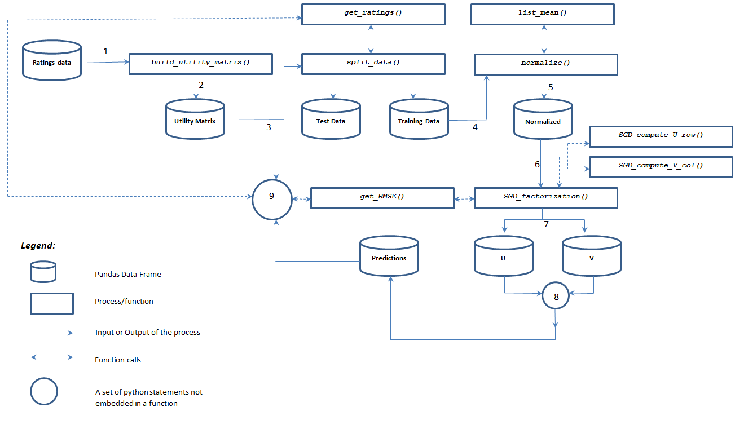
High level design of Recommender-2
Note: Refer to the main document for a detailed explanation of the steps and work flow

Slide 7
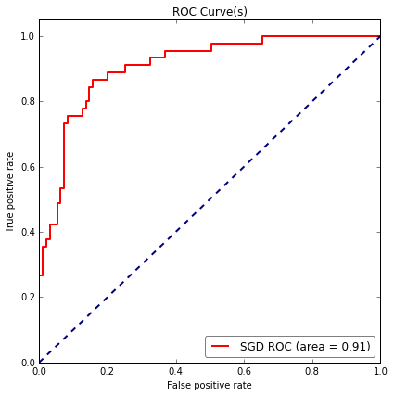
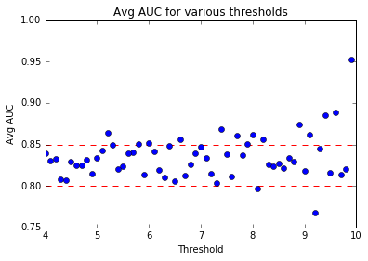
Recommender-2 performance metrics
Test data AUC (with 5 as threshold)
Average AUC for various thresholds
Optimal parameters for SGD:
Reg=1
Latent Factors=60
Learning rate=0.00001

Slide 8
Conclusion
Both recommenders have the cold start problem
Cannot determine which recommender is superior unless we perform A/B testing
Drawbacks of recommender-1: We assumed 5 cutoff and requires at least 1000 users to rate the joke pairs in common. What if a user always rates the items below 5? What if an item is not rated by more than 1000 users in common with another item?
Recommender-2 does not have the drawbacks of recommender-1, although both have the cold start problem

